Slide 1

E-COMMERCE WEBSITE
Fintech Mini Project

Slide 2

Name | Roll No | PRN
Kaushal Kachane | 322073 | 22220110
Sanket Chaudhari | 322014 | 22110098
Priyansh Chajjed | 323076 | 22220293
Sufiyan Rahi | 322076 | 22220198
Urvashi Bhalerao | 322010 | 22111286

Slide 3
TABLE OF CONTENTS
01
02
03
04
05
06
Introduction to Fintech and
E-commerce
Project Overview
User Interface and Features
Admin Panel Functionality
Payment Gateway Integration
Database Management

Slide 4
Introduction to Fintech and
E-commerce
Fintech, a fusion of 'financial' and 'technology,' represents the innovative use of technology to deliver financial services more efficiently.
In the realm of e-commerce, fintech plays a pivotal role by revolutionizing how transactions are conducted online.
It encompasses various facets such as online payments, digital wallets, peer-to-peer lending, and blockchain-based solutions.
Fintech empowers e-commerce businesses with data-driven insights, enabling them to make informed decisions and optimize their operations.
Through advanced analytics and AI-driven algorithms, businesses can gain valuable insights into customer behavior, market trends, and competitive dynamics, allowing them to enhance product offerings, personalize marketing strategies, and drive sustainable growth in the digital marketplace.

Slide 5

Project Overview
Dynamic E-commerce Platform: Our team has developed a dynamic e-commerce website tailored to meet the modern consumer's needs.
Technology Stack: Leveraging PHP, MySQL, and Razorpay, we've crafted a platform that seamlessly integrates online shopping with secure payment processing.
User-Friendly Interface: The website boasts a user-friendly interface designed to enhance the shopping experience.
Comprehensive User Features: Users can easily navigate through the website, explore a wide range of electronics items, add products to their cart, and complete transactions securely.
Admin Panel Functionality: Administrators have access to comprehensive tools to manage orders, users, and electronic items catalog efficiently.

Slide 6

User Interface and Features
The user interface of our e-commerce website is designed to be intuitive and visually appealing.
The homepage serves as a visually engaging landing page that showcases featured products, promotions, and popular categories. Organized product listings with filtering and sorting options enable easy browsing for users.
Detailed product pages provide comprehensive information, including images, descriptions, specifications, and customer reviews.
A seamless cart management system and a streamlined checkout process with multiple payment options enhance the overall shopping experience.
Additionally, users can create and manage wish list to save items for future purchase.

Slide 7

Admin Panel Functionality
The admin panel provides comprehensive functionality for website management, including access to order details, user management, and catalog management.
Administrators can view and manage orders, track order statuses, and update order information as needed.
User management capabilities include registration, login, and account permissions.
Admins can also add new electronic items to the catalog, update product information, and remove outdated or discontinued items.

Slide 8

Payment Gateway Integration
Our website leverages Razorpay as the primary payment gateway, ensuring secure and seamless online transactions.
Razorpay is seamlessly integrated into our e-commerce platform, providing users with a hassle-free payment experience.
It offers multiple payment options, including credit/åebit cards, net banking, UPI, and digital wallets.
With robust encryption protocols and fraud detection mechanisms, Razorpay ensures the highest level of security tor user transactions.
The intuitive checkout interface minimizes friction in the payment processe reducing cart abandonment rates and improving conversion rates.
Additionally, Razorpay enables quick settlement of funds, enhancing cash flow management for businesses.

Slide 9

Database Management
The database management aspect of our e-commerce website plays a crucial role in storing and organizing data related to users, products, orders and transactions, MySQL serves as the relational database management system (RDBMS) powering our website s backend infrastructure.
It provides a reliable and scalable solution for storing structured data efficiently.
Our database schema is designed to optimize performance, ensure data integrity, and facilitate seamless interactions between different components of the website.
Key tables include Users (storing user account information), Products (containing details of all available products), Orders (recording information about user orders), and Transactions (loggin} details of payment transactions).
MySQL's reliability, scalability, and robust feature set make it an ideal choice or managing the data-intensive operations of our e-commerce platform, ensuring smooth operations and optimal performance.

Slide 10

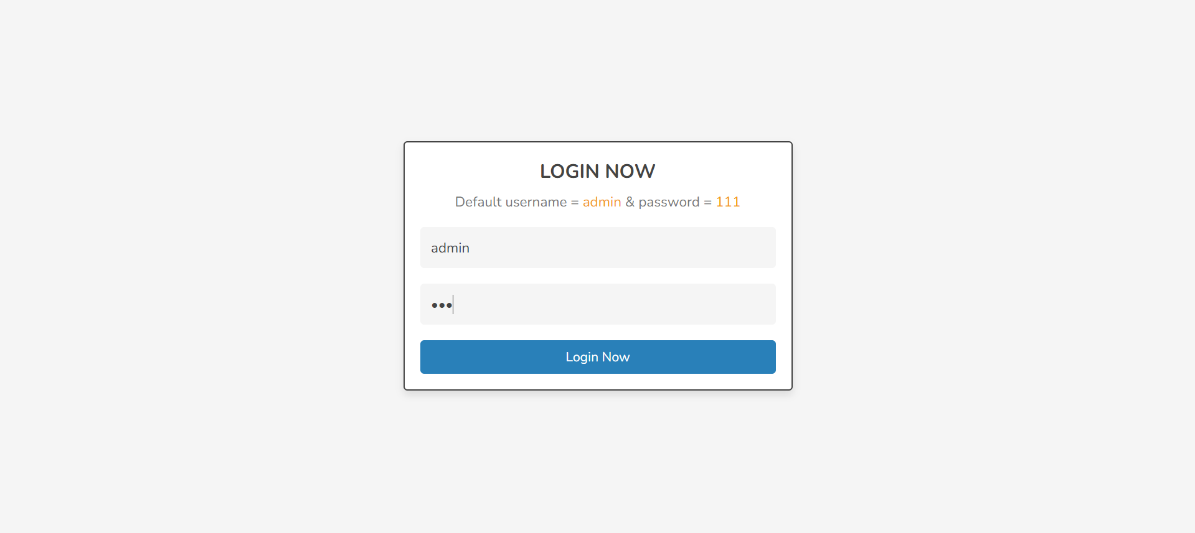
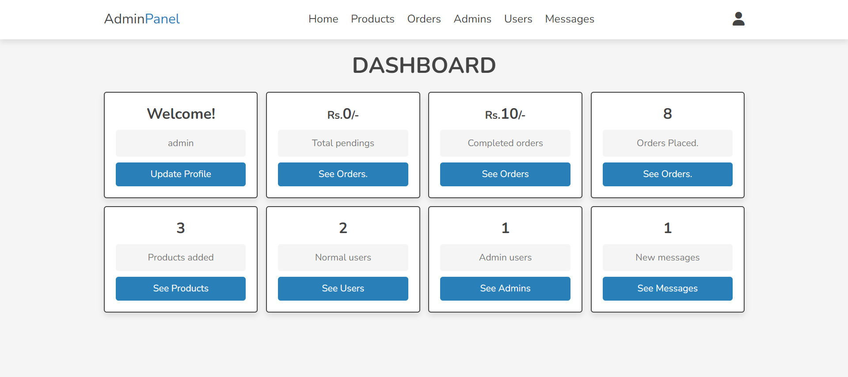
Project Outputs

Slide 11
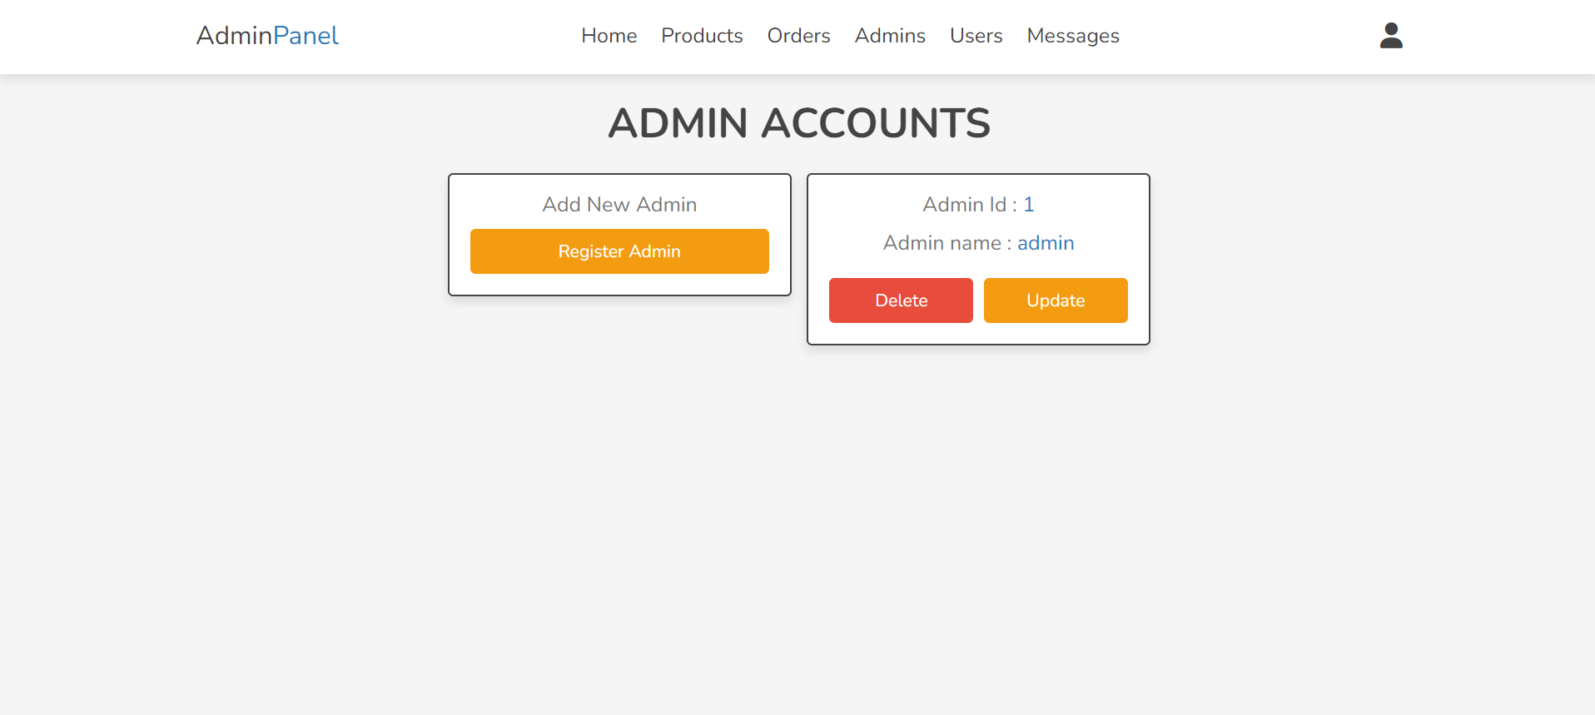
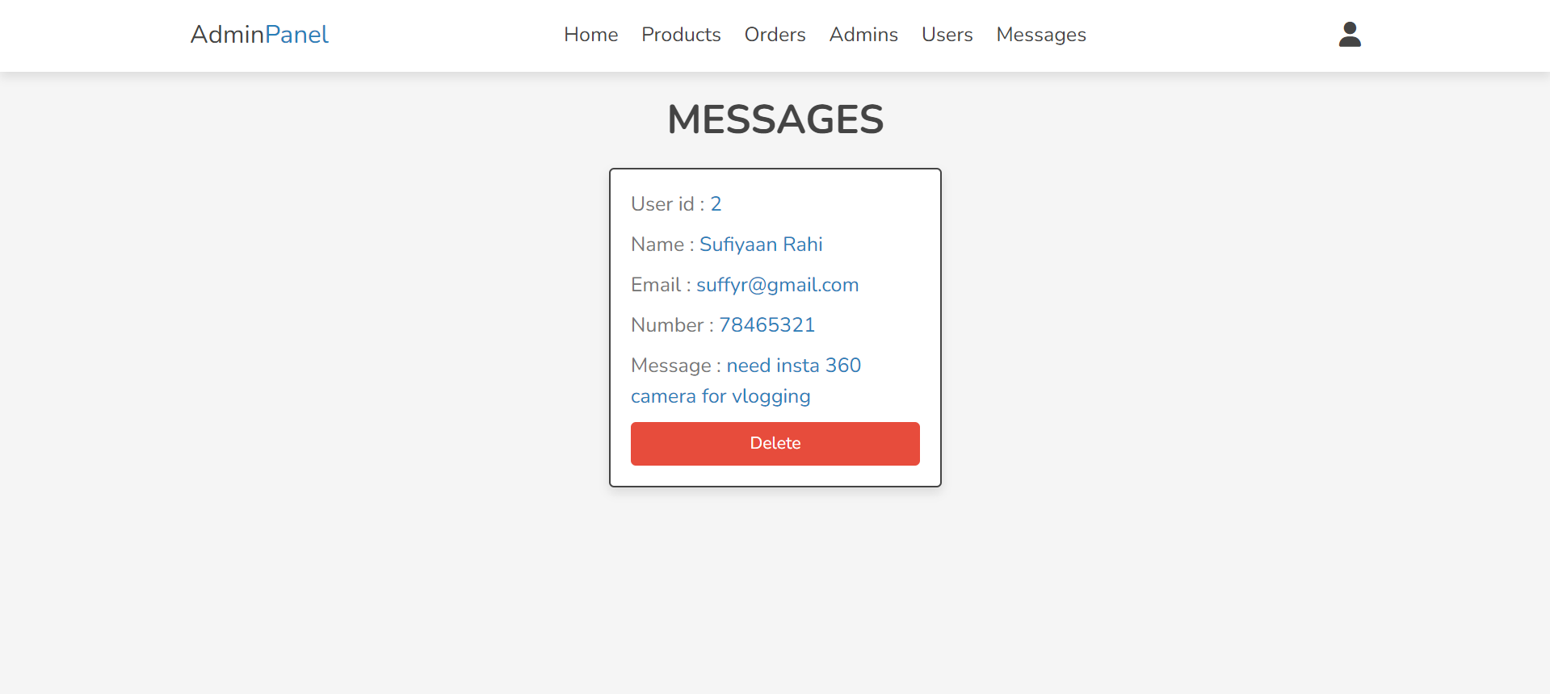
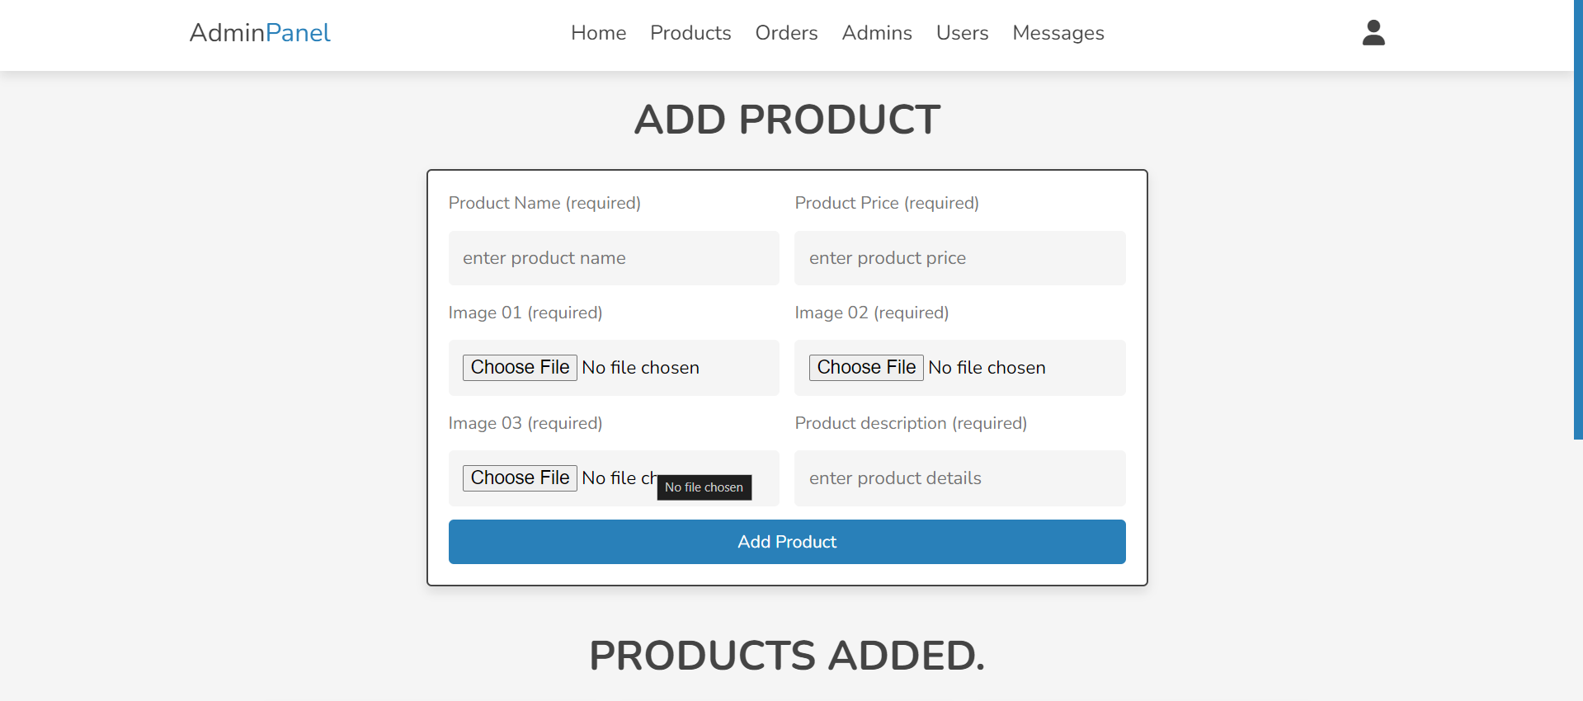
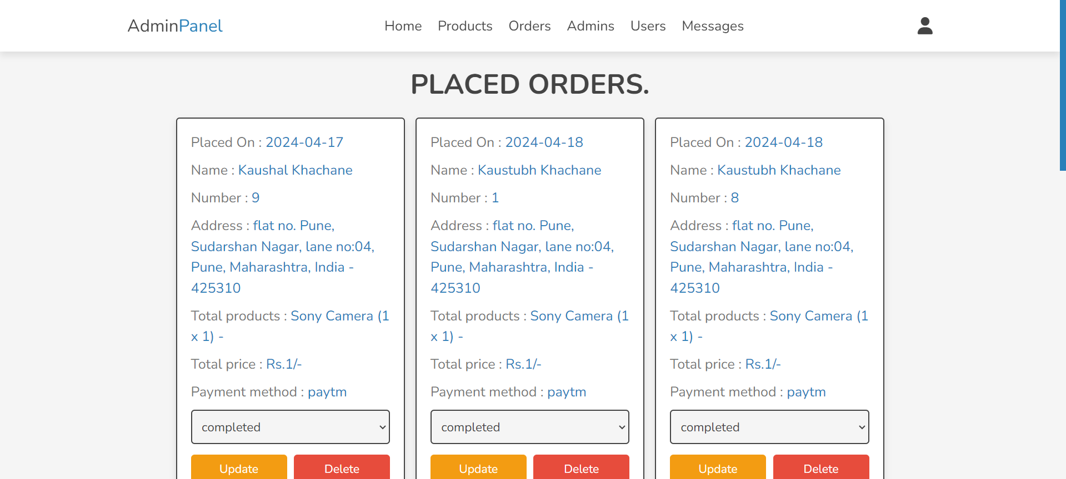

Slide 12

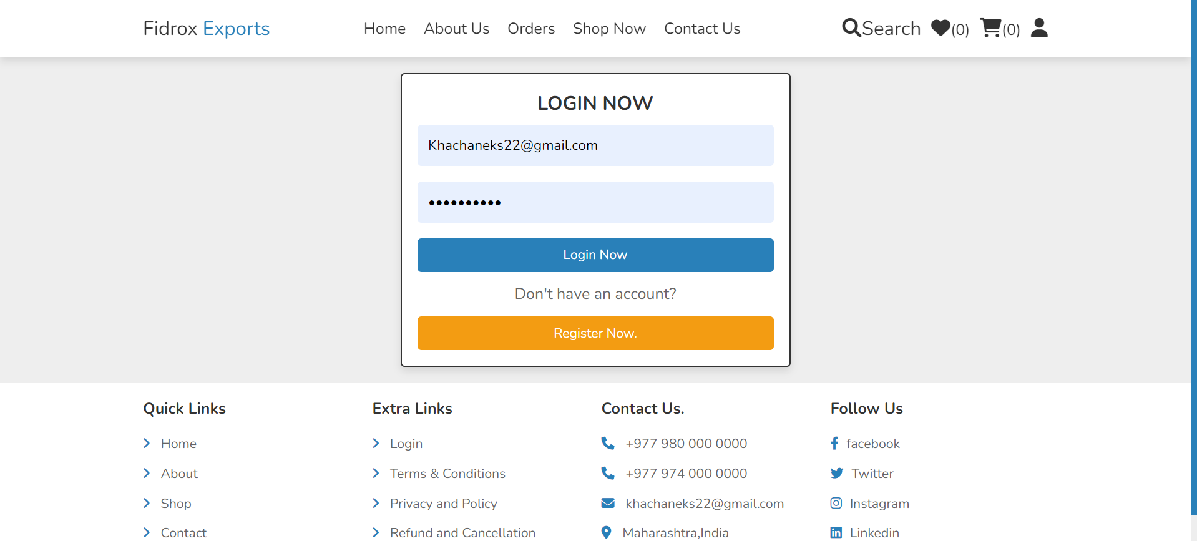
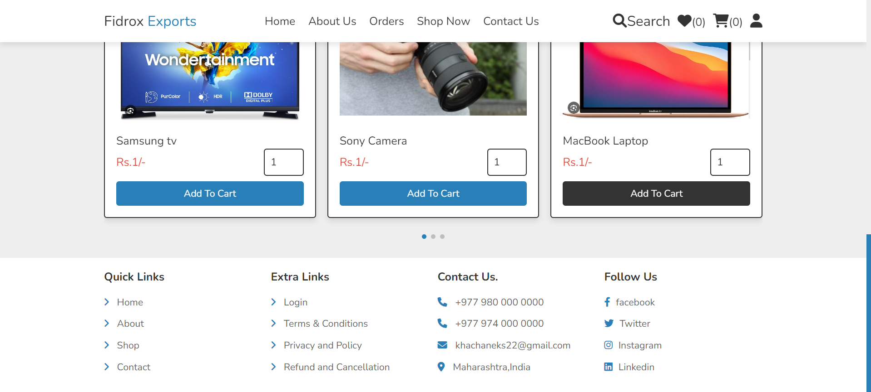
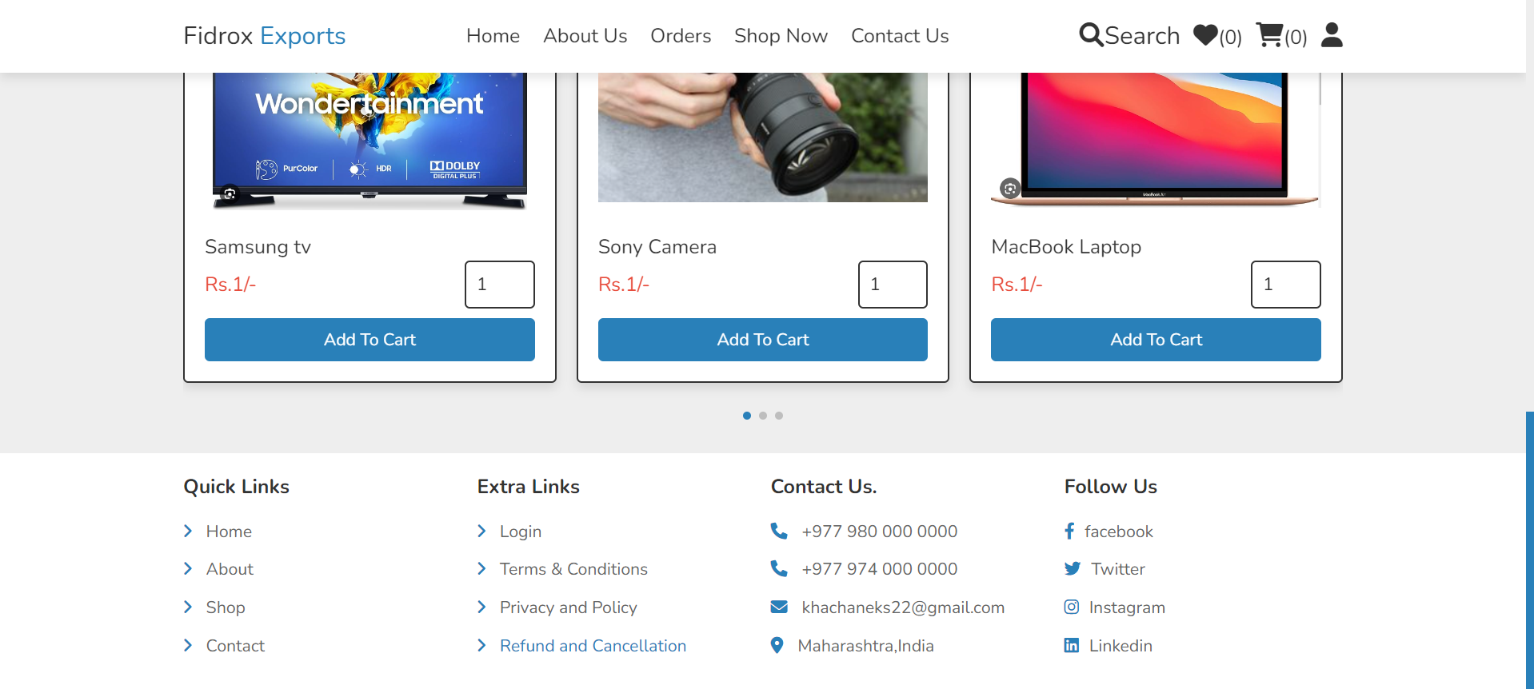
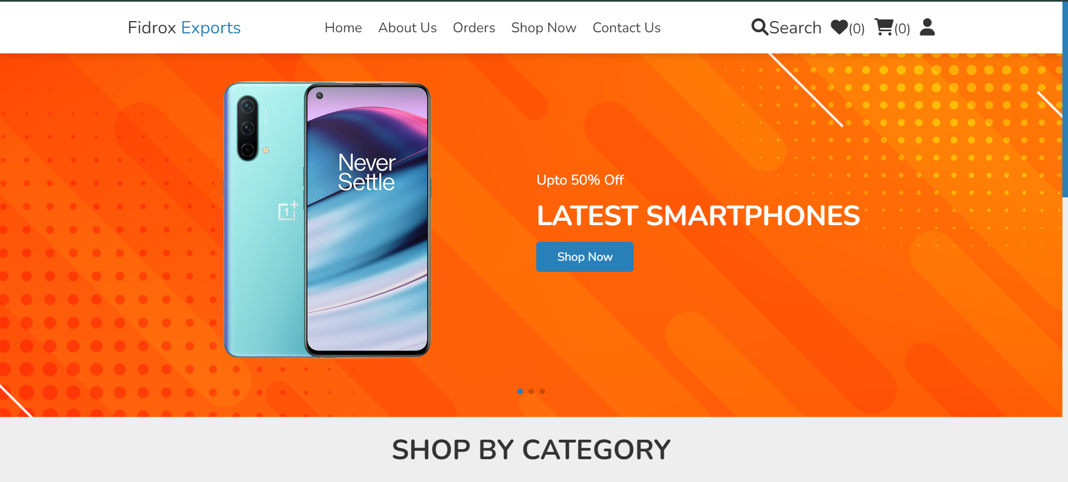

Slide 13

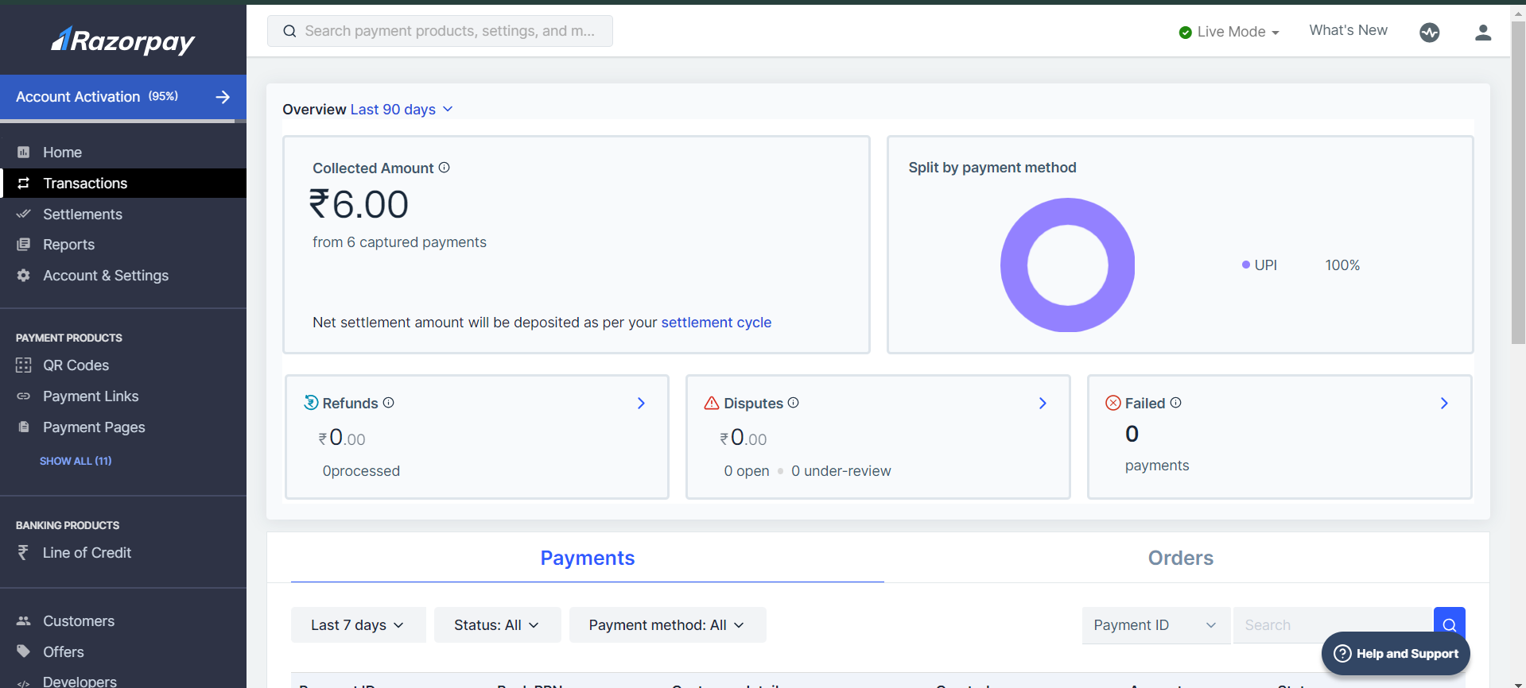
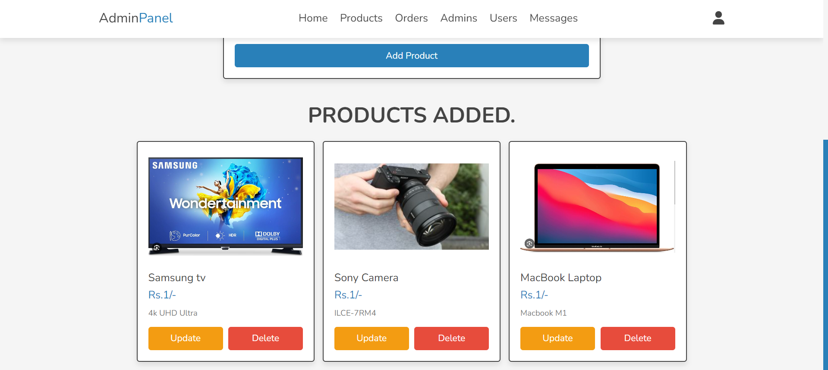
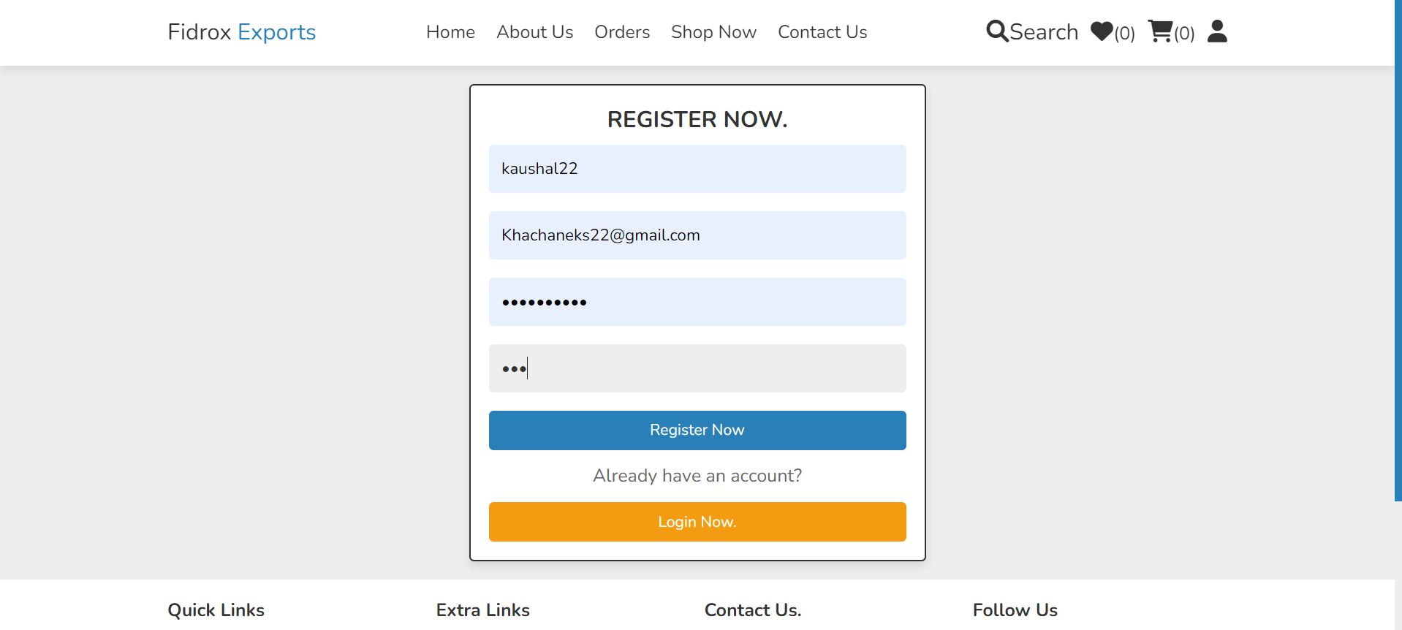
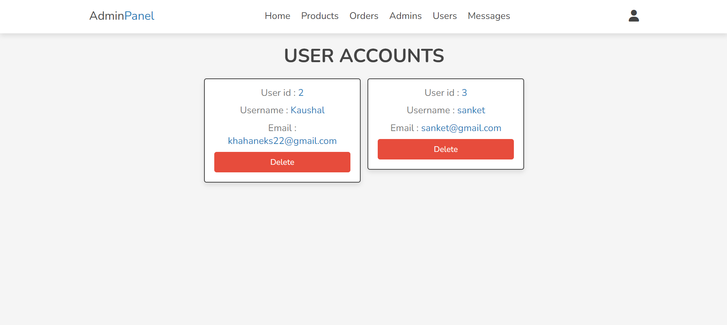

Slide 14

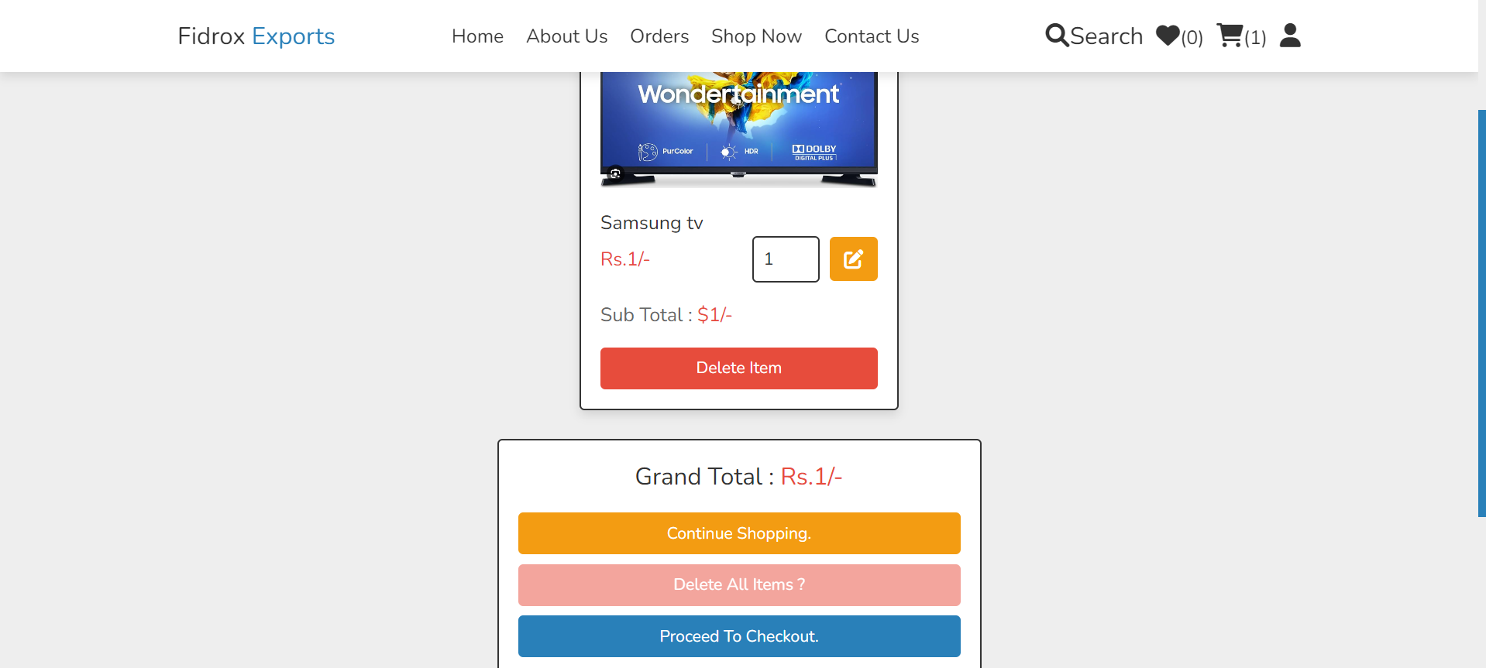
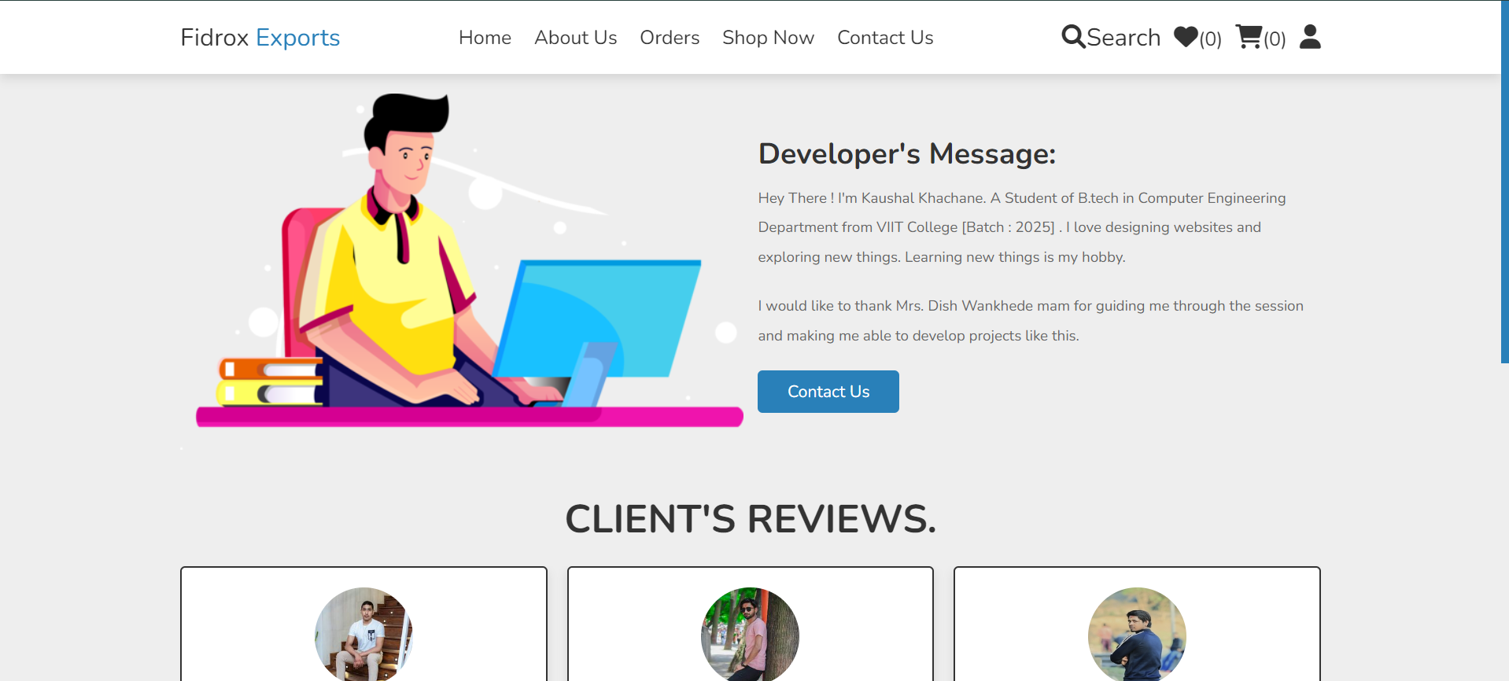
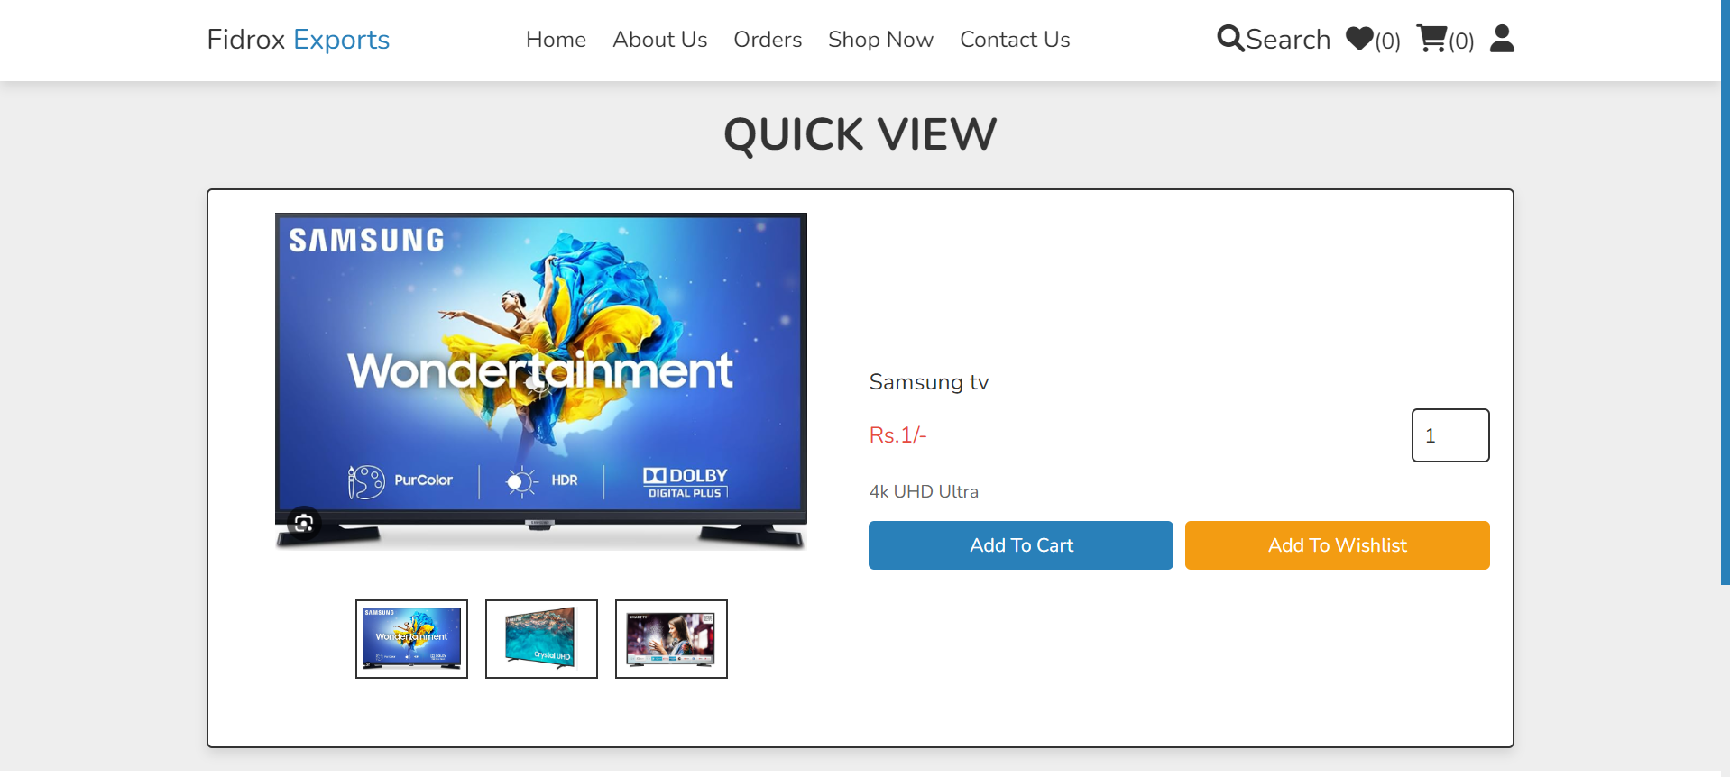
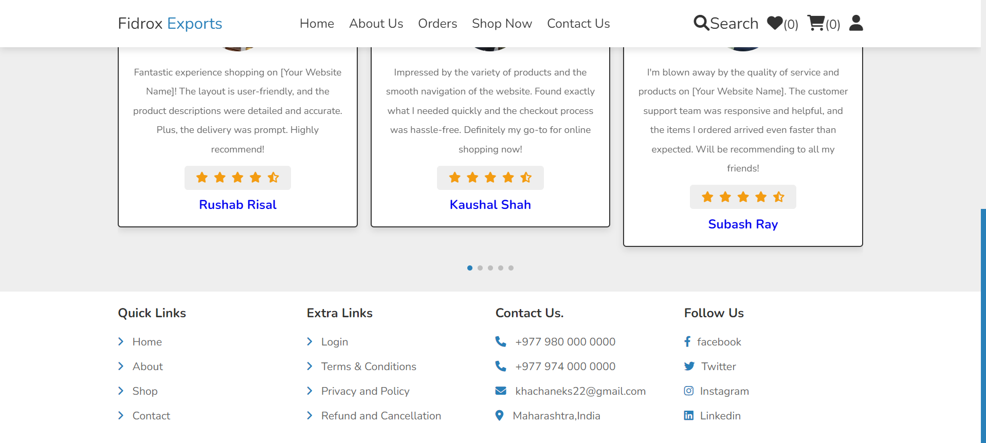

Slide 15

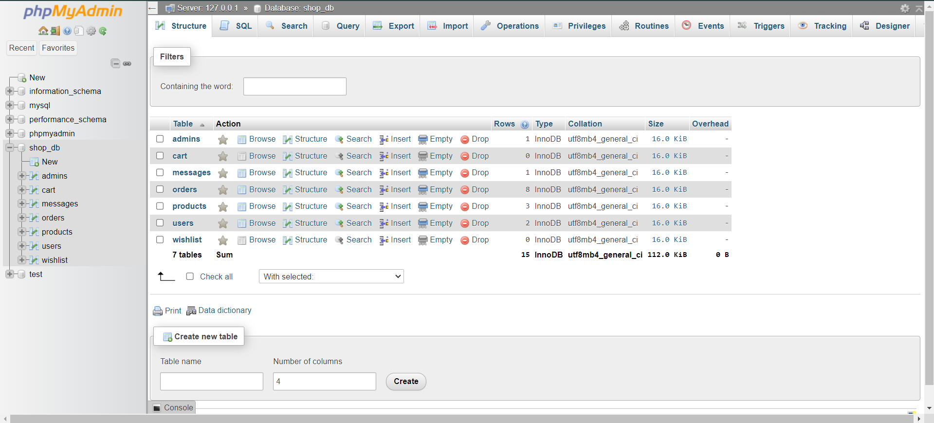
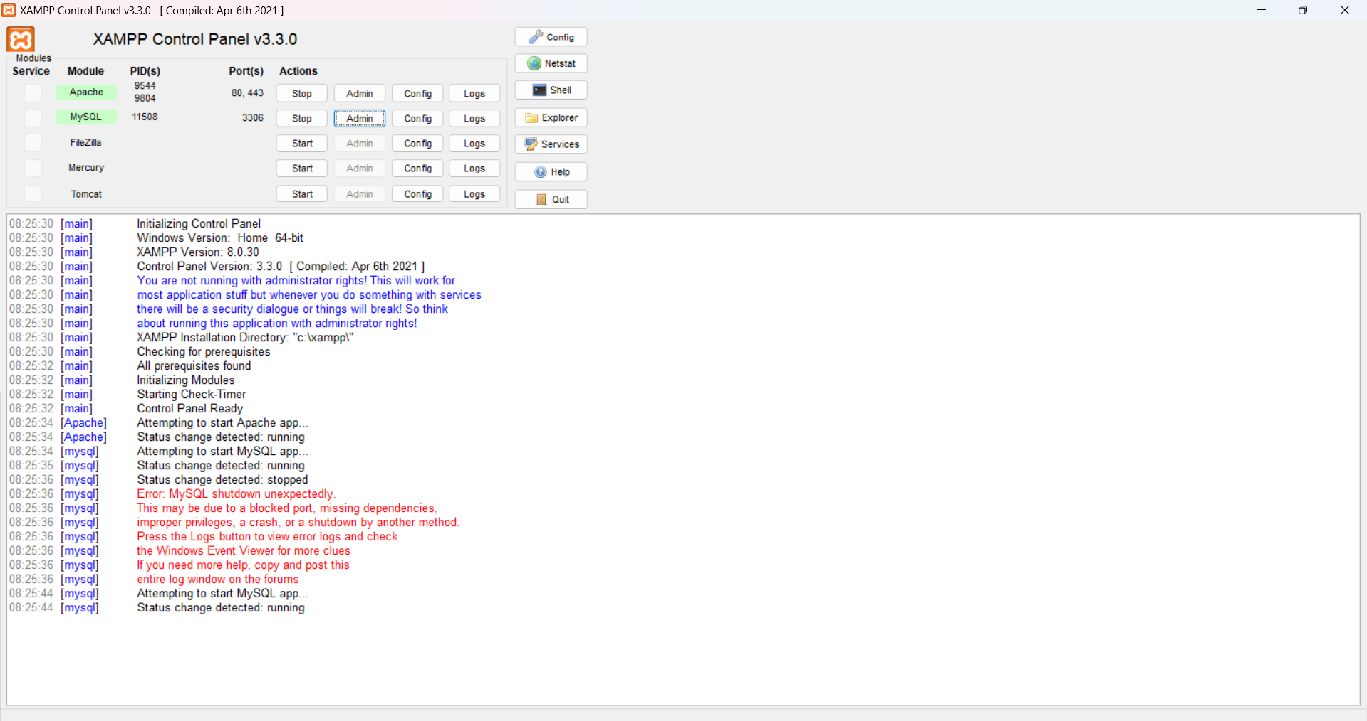
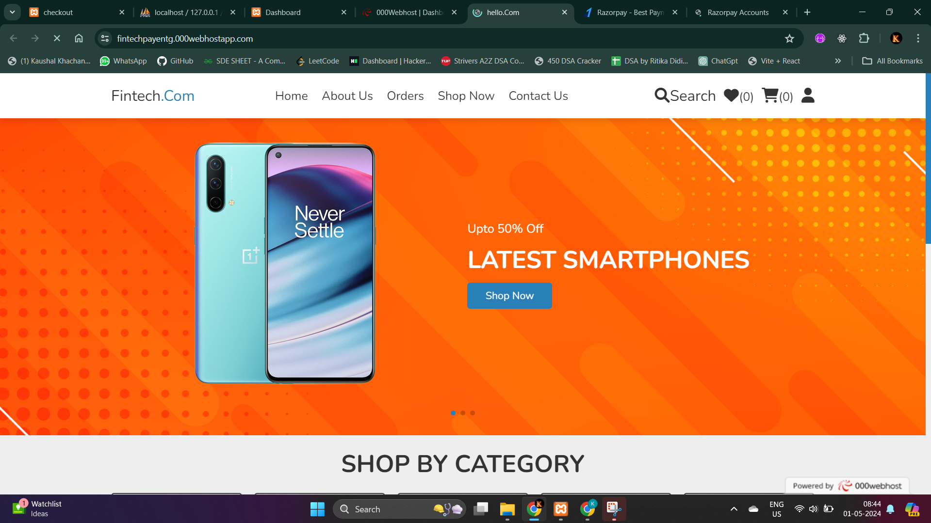

Slide 16
Future Scope
Looking ahead, there are several avenues for growth and enhancement in our e-commerce platform.
We can explore the integration of artificial intelligence and machine learning algorithms to personalize user experiences further, recommend products based on past behavior, and optimize inventory management.
Additionally, expanding our payment gateway options to include more diverse and globally recognized providers can broaden our reach and cater to a wider audience.
Furthermore, enhancing mobile responsiveness and developing dedicated mobile applications can tap into the growing trend of mobile shopping.
Lastly, leveraging data analytics for insights into consumer behavior and market trends can drive strategic decision-making and foster continuous improvement.
With these future endeavors, we aim to stay at the forefront of innovation and continue providing exceptional value to our users.

Slide 17
Conclusion
In conclusion, our dynamic e-commerce platform represents a significant step forward in catering to the needs of modern consumers.
With a robust technology stack comprising PHP, MySQL, and Razorpay, we've ensured a seamless and secure shopping experience.
The user-friendly interface enhances engagement, while comprehensive features empower users to navigate, explore, and transact with ease.
Additionally, the admin panel provides efficient tools for order management, user administration, and catalog maintenance.
Overall, our platform is poised to revolutionize online shopping by combining convenience, security, and functionality.

Slide 18

THANK You!

